Slide 1
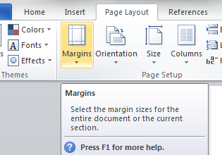
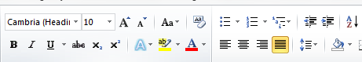

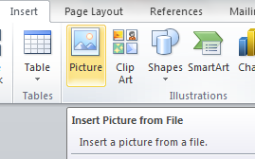
Chapter 17: Document Production (Word)
Task 7
1. Using a suitable software package, load the file Report.RTF 2. Save this document with a new file name. 3. Set the page size to A4 and the orientation to landscape. 4. Set the Margins to: Top and bottom margins to 2 centimetres Left and right margins to 1.5 centimetres 5. Place in the header: Today’s date left aligned Centre number and candidate number right aligned. 6. Place in the footer: Automated file name and path left aligned Automated page numbers right aligned. 8. At the start of the document enter the title GAME CONSOLES 2013 and apply title style. 9. Below the title, add a subtitle and apply subtitle style: Draft Report by: and add your name.
House Style Specification Sheet Title: Serif, Bold, 30pt, Right Aligned Subtitle: Serif , Italic, 16pt, Underlined, Centre aligned Subheading: Serif, 14pt, Centre Aligned, Underlined and one clear line space after each subheading. Body Text: Sans Serif, Single Line Spacing, 11pt and Fully Justified. One clear line space after each paragraph.

Slide 2
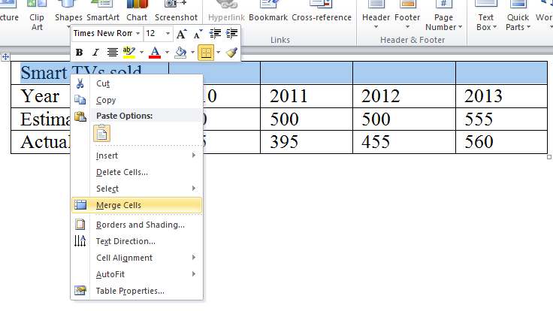
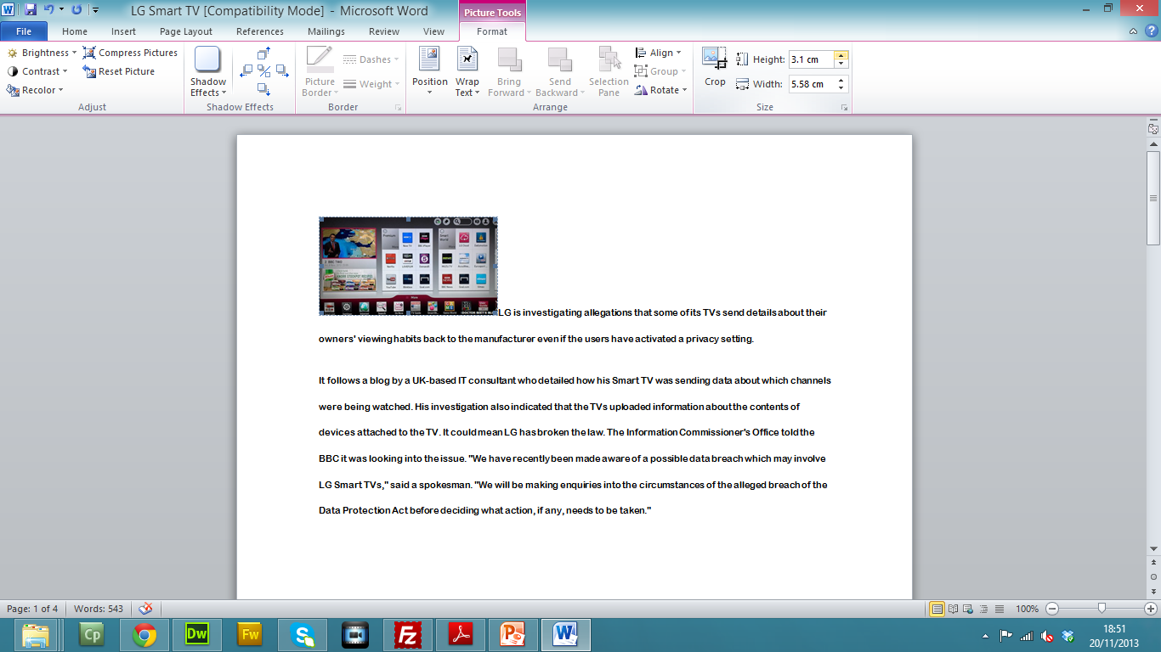
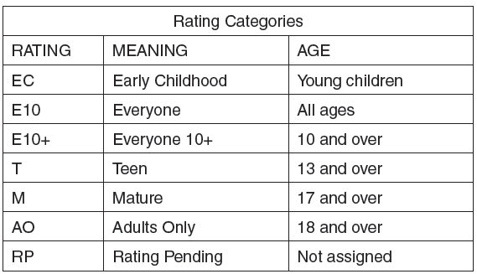
Chapter 17: Document Production (Word)
Task 7
10. Format all the text after the subtitle into three equally spaced columns with 1 centimetre spacing between. Apply the body text style. 11. Identify the 8 subheadings in the document and apply style. 12. Change the numbered list which starts: 1. User control interface… to bullet points. Format the list so that the bullet points are aligned with the left margin. 13. Format the paragraph which starts Some video games… to display: An outside 3 to 4 point border Light grey shading (10 – 25%) 14. Edit the table so that it looks like this: 15. Format the text in the table as body text.

Slide 3
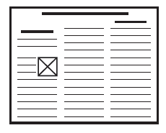
Chapter 17: Document Production (Word)
Task 7
16. Format the top row of the table to be bold and italic. 17. Format the second row of the table to be bold and centre aligned. 18. Make sure the table: • Fits within the column with no text wrap • Displays an outside border but no gridlines when printed 19. Move the paragraph which starts The development of new consoles… so it is positioned below the subheading Developments 20. Replace the text [Insert picture here] with the image Report.JPG 21. Crop the image to remove only the stars from the left hand side. 22. Re-size the image to 4 centimetres wide. Maintain the aspect ratio. 23. Align the image with the top of the paragraph starting Gaming technology has… to the right margin. Make sure the text wraps round the image. 24. Spell-check and proof-read the document. 25. Make sure there is a single space after: The list The table. Remove the extra line spaces Make sure tables do not go over two columns.

